Slide 1
QuizWiz
A QUIZ/TRIVIA APP
By -
Naimur Rahman
Roll - 1907031
Md. Atique Faisal
Roll - 1907038
Zobayer Abedin
Roll - 1907045
Asfaq Mahmud Saif
Roll - 1907046
Md. Zakaria Hossain
Roll - 1907056
Dept – Computer Science and Engineering
Year - 3rd
Semester – 2nd
Session – 2021-22

Slide 2
MAIN FEATURES:
Create quiz
Participate/Join in a quiz
Play API generated quizzes
See results of created & participated quizzes

Slide 3
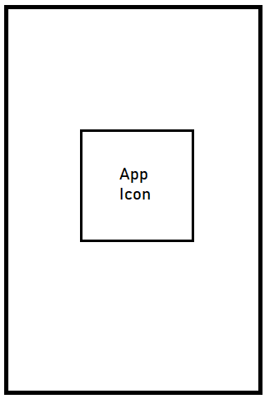
OTHER FEATURES:
Splash Screen
Sign up
Sign in
User profile
Splash Screen Mock Up

Slide 4
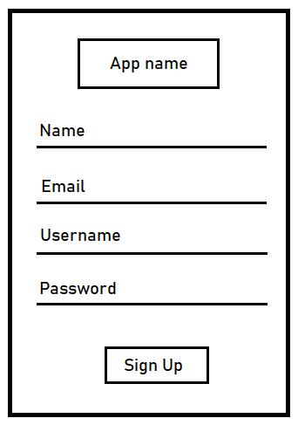
SIGN UP:
Username
Name
Email
Password
Sign Up Mock Up

Slide 5
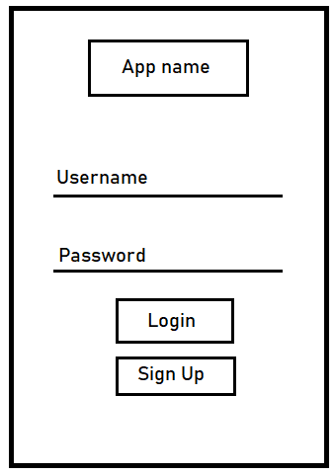
SIGN IN:
Username
Password
Log/Sign In Mock Up

Slide 6
QUIZ CREATION:
Create questions, answer, correct answer
Stored in firebase database
Created quiz has a quiz code and password protected

Slide 7
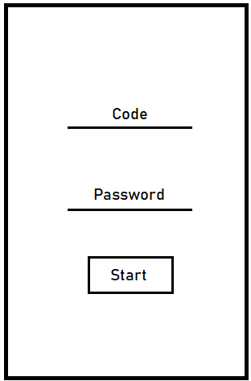
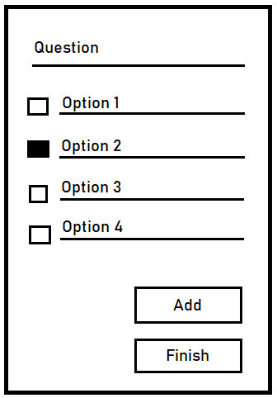
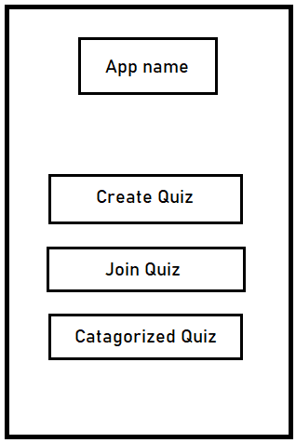
QUIZ CREATION:
Correct
Answer
Quiz Creation Mock Up

Slide 8
QUIZ PARTICIPATION:
Join using code and password
Select the answers
Scoreboard shown after finishing quiz

Slide 9
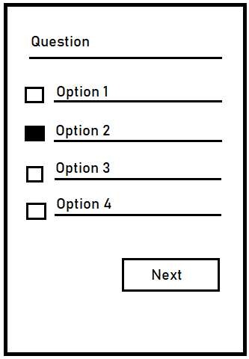
QUIZ PARTICIPATION:
Chosen
Answer
Indicator
Quiz Participation Mock Up

Slide 10
API GENERATED QUIZ:
Quiz is generated from using API
A fixed number of questions will be generated (e.g. 10)
We will use “Open Trivia API”
Open Trivia DB: Free to use, user-contributed trivia question database (opentdb.com)

Slide 11
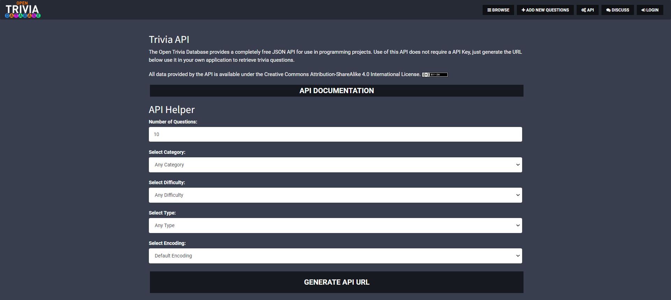
API GENERATED QUIZ:
API Generated Quiz Configurations

Slide 12
API GENERATED QUIZ:
Chosen
Answer
Indicator
API Generated Quiz Mock Up

Slide 13
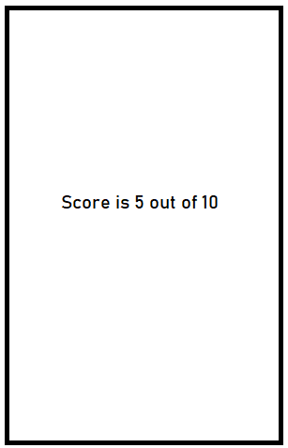
RESULTS:
See results for created quizzes
See results for participated quizzes
Results Mock Up

Slide 14
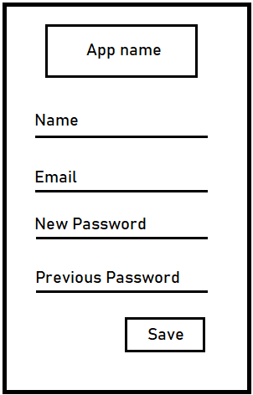
USER PROFILE:
Change Name
Change E-mail
Change password
User Profile Mock Up

Slide 15
APPLICATIONS:
CT or any test for educational purposes
Self learning
Trivia practice
Time pass

Slide 16
ANY QUESTIONS…??
THANK YOU

